Slide 1

University Institute of Liberal Arts and Humanities
Course Name – Communication Skills
Course Code – 23PCH-105
CROSS CULTURAL COMMUNICATION
DISCOVER . LEARN . EMPOWER

Slide 2
COURSE OBJECTIVES
The Course aims to:
1 | Augment students overall communication and interpersonal skills by making them realize the importance of good oral and written English Language in professional life.
2 | Enrich their reading capability with special emphasis on expanding vocabulary and grammatical formations.
3 | Build exceptional speaking, reading and writing skills by correcting grammatical errors and pronunciation through practice.
4 | Enhances soft skills by fostering self awareness, confidence and a positive attitude in students’ ability to communicate effectively in English.

Slide 3

COURSE OUTCOMES
Space for visual (size 24)
On completion, the students are expected to
CO Number | Title | Level
CO1 | Apply appropriate Listening, Speaking, Reading and Writing Skills (LSRW Skills) with correct non-verbal cues to attain expertise in soft skills. | Apply
CO2 | Apply correct contextual and comprehensible written text in the form of paragraph writing, short compositions business correspondence, using logical support and argument in a wide range of communication situations. | Apply
CO3 | Demonstrate linguistic competence while speaking and during presentations through accuracy in grammatical usage, vocabulary, pronunciation and intonation. | Apply
CO4 | Evaluate information as critical readers, speakers and writers applying ethics in communication and being sensitive in cross cultural communication. | Evaluate
CO5 | Create original, digital content for websites, blogs, vlogs and personal social media profiles etc. | Create
Wordpress.com

Slide 4
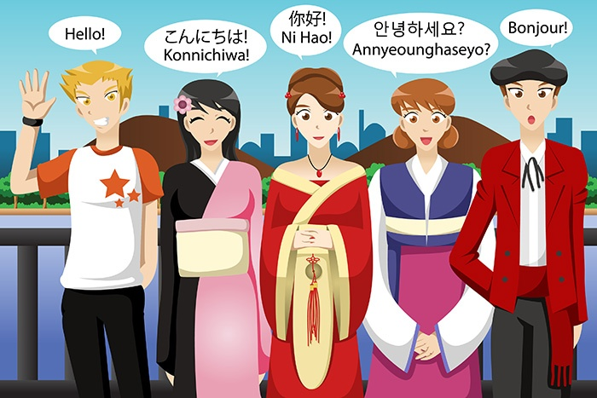
Topics
Culture
Cross Cultural Communication
Introduction and Meaning
Significance
Elements
Cross Cultural Context
Barriers to Cross-Cultural Communication
Case Study
4

Slide 5
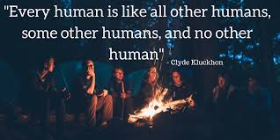
5

Slide 6
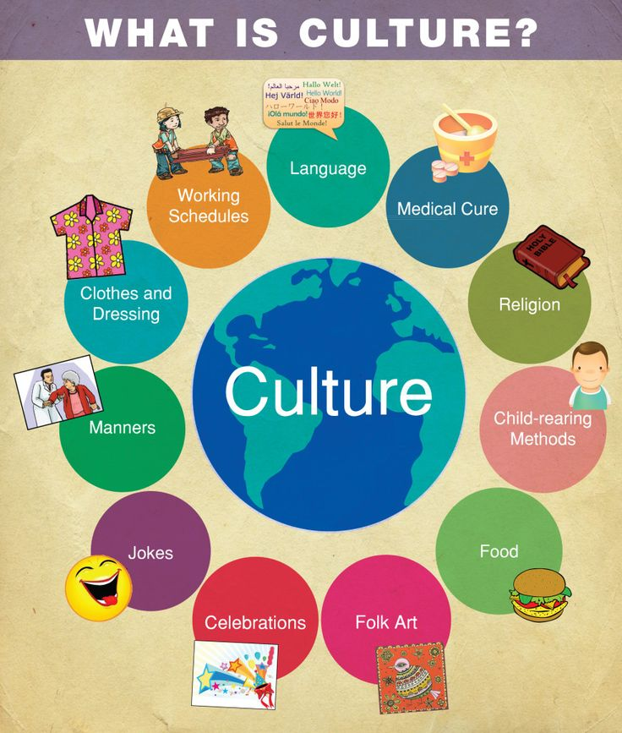
Culture
Culture is a complex whole which includes knowledge, beliefs, art, law, morals, customs, and any other capabilities and habits acquired by man as a member of society.(Tylor, 1871)
Culture is a way of life.
6

Slide 7

Characteristics of Culture
Culture is shared, not inherent, but learned
Rooted in deep seated beliefs and symbols
Basis for self-identity
Ever-changing and dynamic
7

Slide 8

What is Cross Cultural Communication?
Cross-cultural communication is a field of study that looks at how people from differing cultural backgrounds communicate, in similar and different ways among themselves.
-Elena Smirnova
10

Slide 9
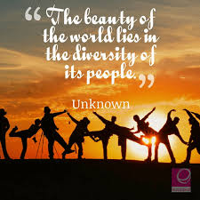
Significance
Helps in understanding diverse work-force
Prepares the company for global scenario
Helps in developing an understanding of how people from different cultures
speak
communicate &
perceive the world around them
11

Slide 10
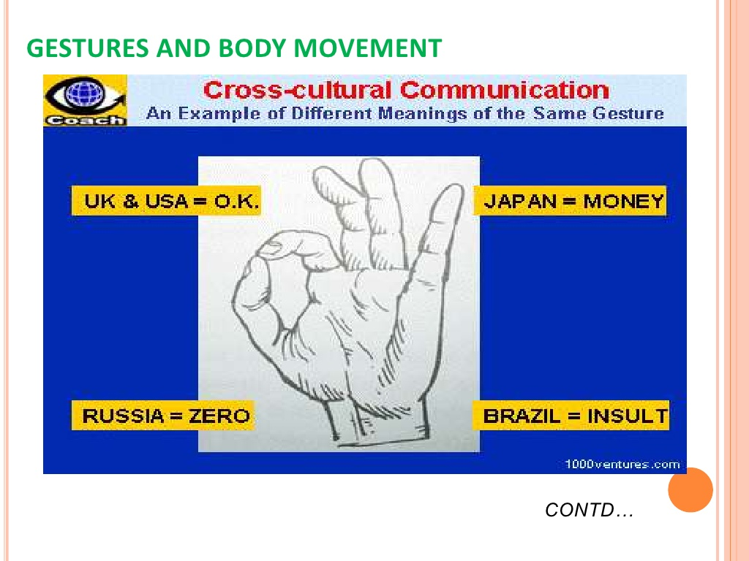
One Gesture Different Interpretations
24

Slide 11
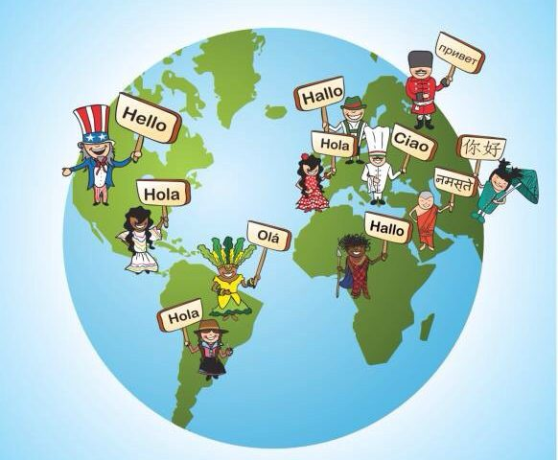
Elements of Cross- Cultural Communication
Element of Language
Element of Culture
High Context vs. Low Context Culture
Informal vs. Formal Culture
Contact vs. Non-Contact Culture
Element of Symbol
Element of Values
12

Slide 12
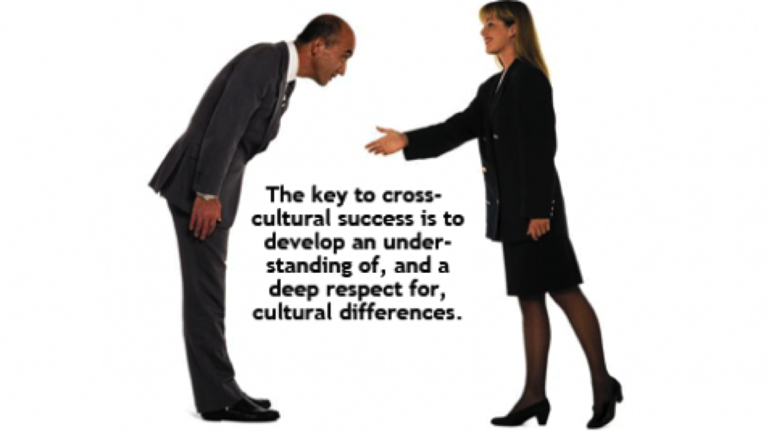
Cross Cultural Communication
Context
Sending a message
Receiving a message
Differences to consider
13

Slide 13

Sending a Message
Speak slowly.
Maintain etiquette.
Be careful with the use of jargon, slang, jokes, sarcasm in conversation.
Keep it simple.
Keep your body language positive and welcoming.
Avoid closed questions.
hdimagegallery.net
14

Slide 14
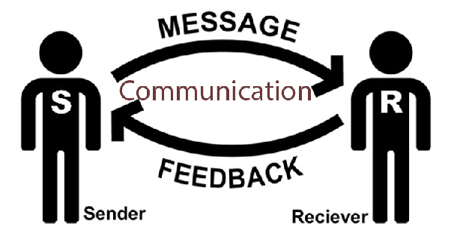
Receiving a Message
Use active listening.
Clarify you are understood clearly.
Do not correct other person’s speech.
Give the other person time to respond and to take in your message.
Translate the message into their language if necessary.
www.spencerstuart.co
14

Slide 15
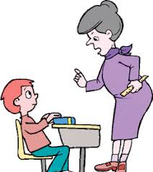
Differences to Consider
Use of hands while talking.
Physical distance between communicators.
Speed and volume of speech.
Use of First Name vs. Titles.
Use of Facial Expressions – eye contact, smile etc.
Assertiveness.
thebrigde.com
14

Slide 16
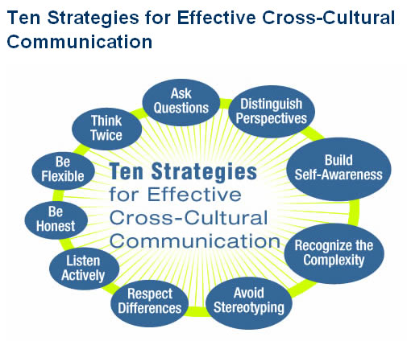
Cross-Cultural Communication Needs
Listening Skills
Speaking Skills
Observation
Patience
Flexibility
English-ch.com
14

Slide 17

Problems of Cross Cultural Communication
Different communication styles.
Different attitudes towards conflict.
Different approaches to completing tasks.
Different decision-making styles.
Different attitudes towards disclosure.
Different approaches to knowing.
Thailandgermany.com
14

Slide 18
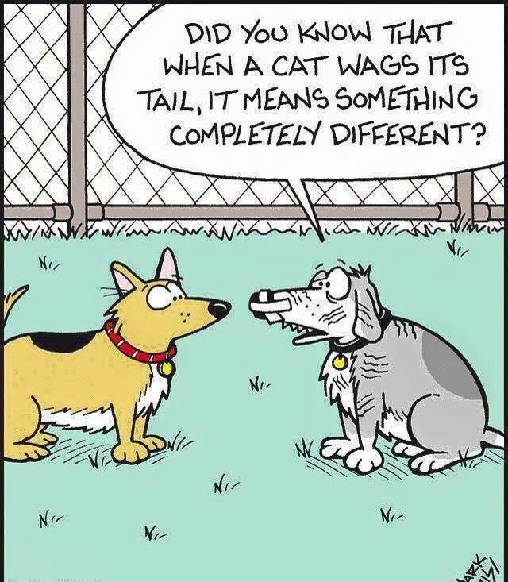
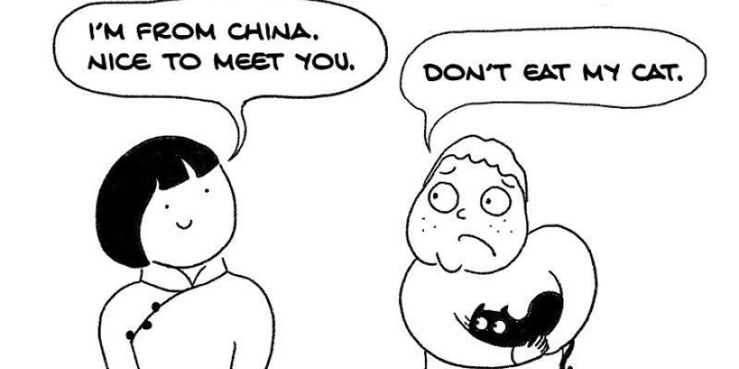
Problems Revisited!
19

Slide 19

Ethnocentrism
A belief in the superiority of the culture or group to which one belongs and a feeling of dislike or being judgmental towards the cultural practices of others.
Term was coined by Ludwig Gumplowicz.
Quora.com
14

Slide 20
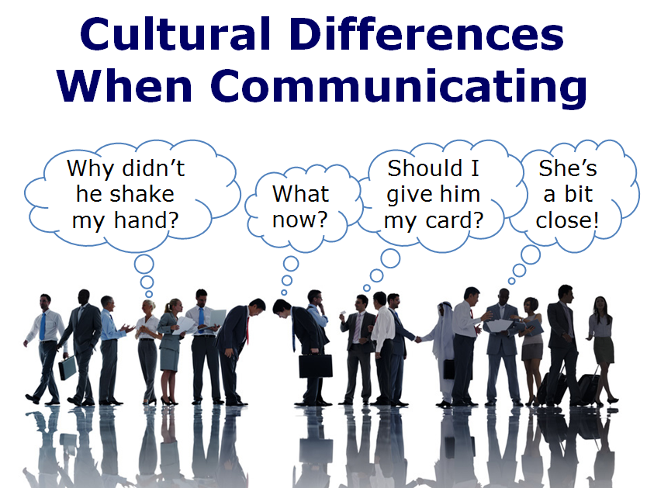
Barriers in Cross-Cultural Communication
Language Barriers
Cultural Barriers
Behaviour
Stereotypes and Prejudices
Emotional Display
Ethnocentrism
Assuming similarities instead of differences
www.trainerbubble.com
14

Slide 21
Overcoming Barriers to Cross Cultural Communication
Gain knowledge regarding the norms or customs of others culture.
Develop appreciation of the cultural differences.
Be open to trying new things.
Be accommodating.
Develop active listening skills.
Use interpreters.
Take workshops, tips and techniques for communicating effectively in cross-cultural work environments.
14

Slide 22
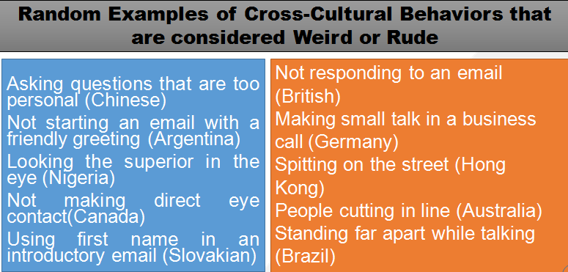
Weird, Rude or Different?!
23

Slide 23
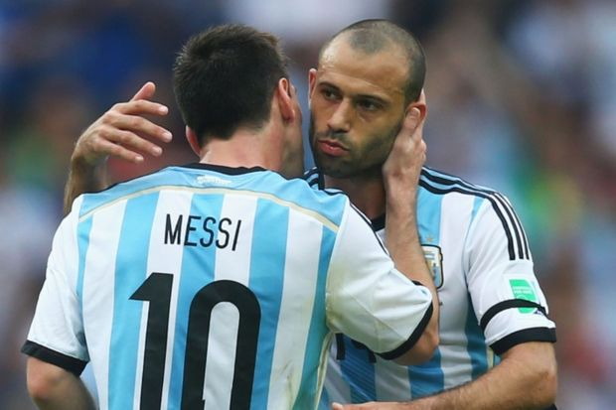
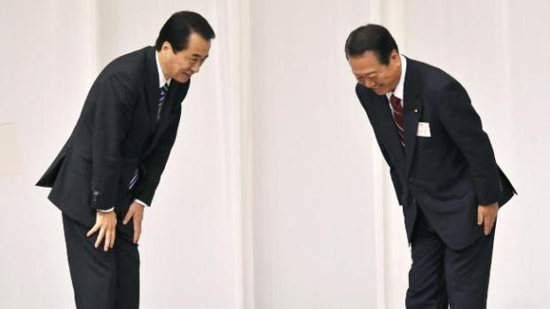
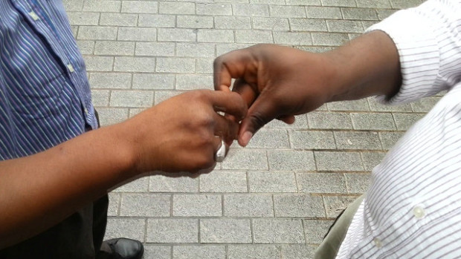
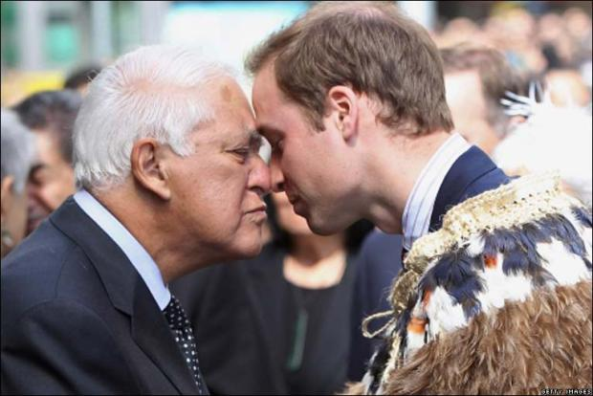

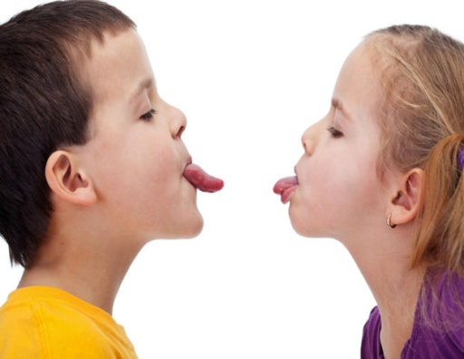
Examples
Greetings in Different Cultures
India: Namaste
Argentina: Kiss on the right cheek.
Japan: A bow.
Nigeria: Snapping fingers handshake.
Russia: A firm handshake.
New Zealand: Hongi (touching noses)
Worldwittj.com
9

Slide 24

29

Slide 25
Applications
Sensitivity towards others while working in cross cultural teams
Bringing cultural tolerance to the workplace
Improvement in work relationships through an understanding of cross-cultural differences
Development of an attitude of acceptance of ideas from other cultures
Prepare students for the role of global citizens

Slide 26
Assessment Pattern
Students are assessed on the basis of the following parameters:
Hourly Test-2
Assignments
Surprise Test
Quiz
End Semester Exam

Slide 27
References
study.com/academy/.../cross-cultural-communication-definition-strategies-examples.ht...
https://www.slideshare.net/tvenkadesh/cross-communication
communicationtheory.org/cross-cultural-communication/
https://www.trainingindustry.com/.../strategies-for-effective-cross-cultural-communication
http://nideffer.net/classes/GCT_RPI_S14/readings/Chap8CharacteristicsofCulture.htm#:~:text=Culture%20has%20five%20basic%20characteristics,cultures%20share%20these%20basic%20features.

Slide 28
THANK YOU
For queries
Email: communicationskills.uilah@gmail.com

